Slide 1
Mental health and Productivity: Insights from Employee Data
HarmonyTech Enterprises
October 2024

Slide 2
Problem:
Solution:
High stress at HarmonyTech Enterprises is lowering productivity due to poor work-life balance and limited mental health support.
Improve Mental Health Support through accessible resources.
Promote Flexible Work to enhance work-life balance.
Provide Stress Management Training to reduce stress in high-impact roles.

Slide 3
Analytical goals
WHY: Analyze how stress, work-life balance, and mental health resources affect employee productivity at HarmonyTech Enterprises.
HOW: Use employee data to identify patterns and provide actionable insights to improve productivity.

Slide 4
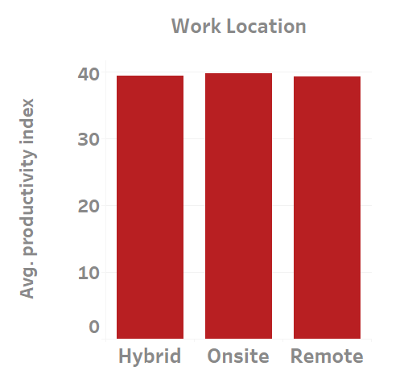
Productivity
Productivity is high at onsight work location and low at remote work location.
Source: Average Productivity index of the employee in different work locations.
(n=5000 Employees)

Slide 5
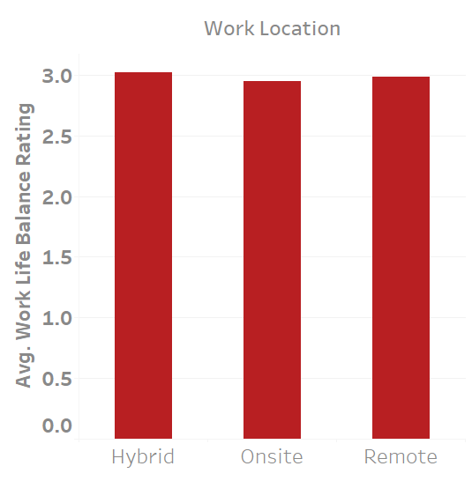
Work-life balance
The Hybrid and remote employees have good Work-life balance rating whereas the onsight employees have low Work-life balance rating
Source: Average Worklife balance rating of the employee in different work locations.
(n=5000 Employees)

Slide 6
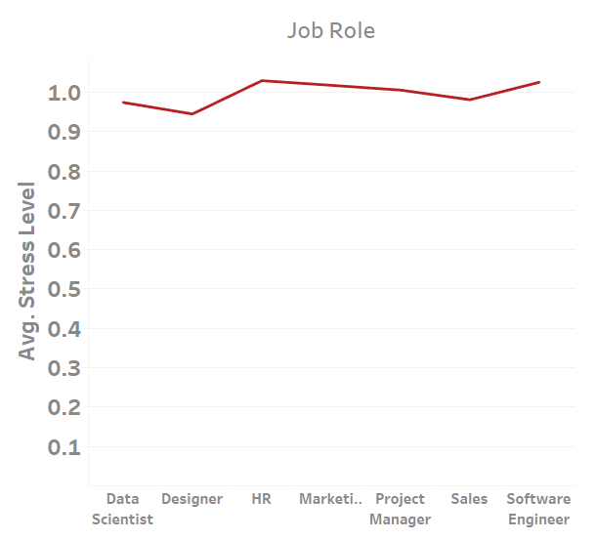
Stress Trend
Stress level varies significantly for different job roles.
HR and Software Engineer role have high stress.
Designer role have low stress.
Source: Average Stress level index of the employee in different job role.
(n=5000 Employees)

Slide 7
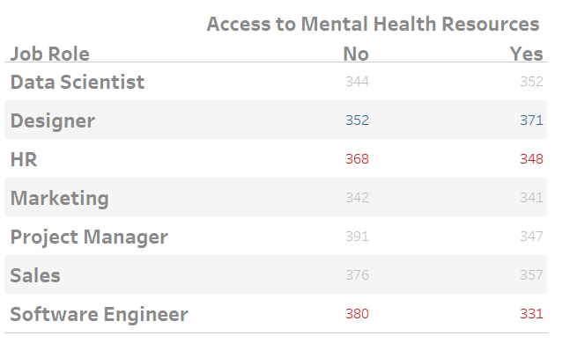
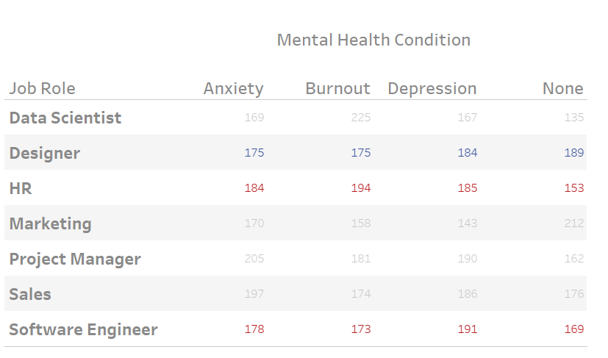
The Reason
Most of HR and Software Engineer have no access to mental health resources wheres most of Designer role have access.
This cause the High Burnout and Depression among the HR and Software Engineers.
Source: Access to mental health and mental health condition of employees at different job roles(n=500 Employees)

Slide 8
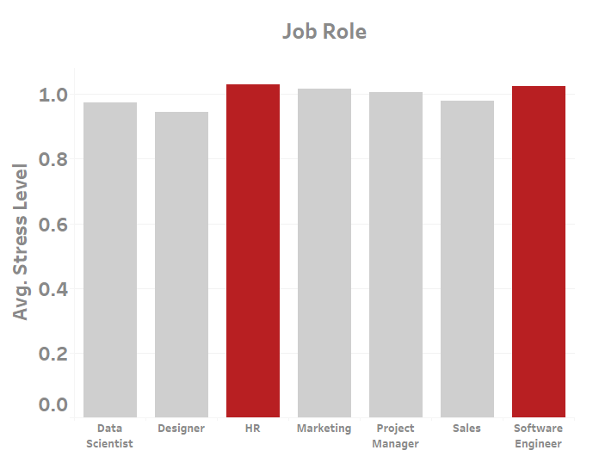
Prioritize HR and Software Engineers
Currently, HR and Software Engineers experience high stress compared to others.
Source: Average Stress level index of the employee in different job role.
(n=5000 Employees)

Slide 9
SUMMARY & CONCLUSION
KEY FINDINGS
Productivity and Stress: Highlight that productivity increases when stress levels decrease.
Work-Life Balance: Emphasize that hybrid and remote work locations foster better work-life balance compared to onsite work.
Role-Specific Insights: Mention the differing stress levels among roles:
HR and Software Engineers: High stress due to limited access to mental health resources.
Designers: Low stress attributed to better access to mental health resources.

Slide 10
RECOMMENDATION
Access to Mental Health Resources: Provide HR and software engineers with Employee Assistance Programs (EAPs) and partner with mental health apps for stress relief.
Flexible Work Schedules: Implement hybrid work models and allow flexible hours to improve work-life balance.
Mental Health Training for Managers: Train managers to recognize burnout and encourage open communication about workload and mental health.
Schedule Mental Health Days: Provide employees with regular mental health days, Where they can rest and recharge without pressure of work

Slide 11
Thank You
- Abdul Hadi S

